Slide 1
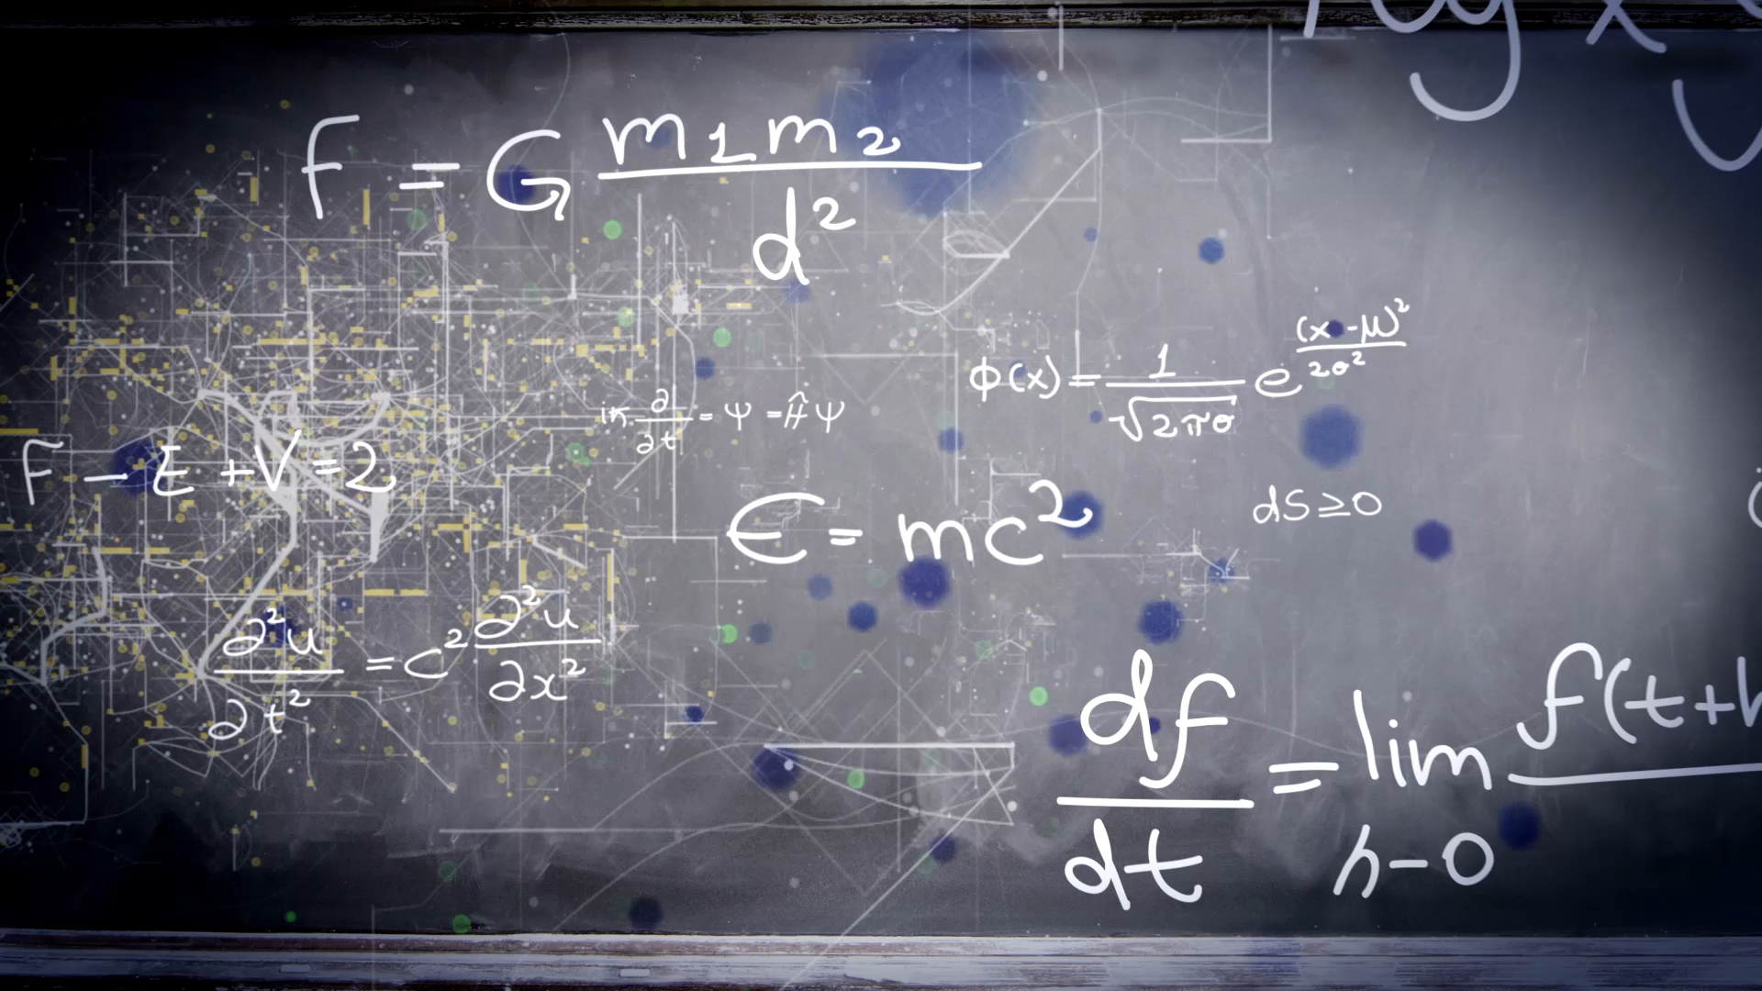
Chemistry seminar class-9 chapter-8 Atmospheric pollution
By: NK,Syed,Aravind,Suki,Yousif and Aadhavan.

Slide 2
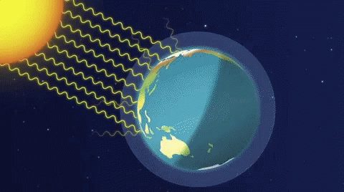

Global warming
About three-fourth of the sun’s energy reaching earth’s surface, which causes increase in the temperature.
Some heat is trapped by green house gases like cfc[chloro-fluoro-carbon].

Slide 3
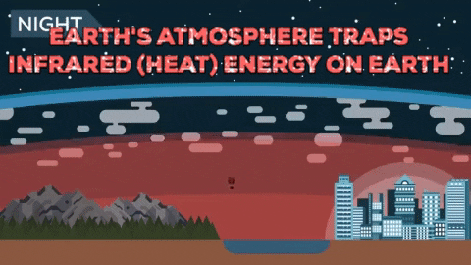
Green house effect
Heating of the earth and its environment due to solar radiation trapped by green house gasses. As carbon dioxide and water vapour in atmosphere is called green house effect.

Slide 4
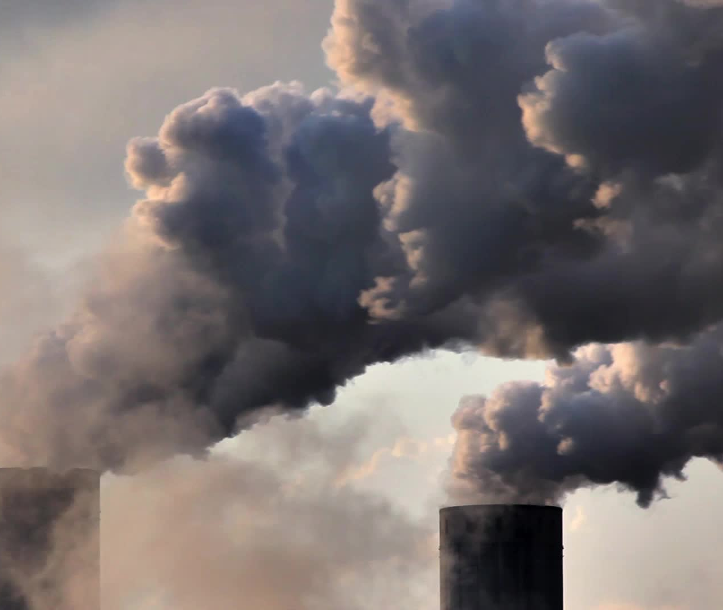
Carbon dioxide
Burning of fossil fuel.
Industrial process
Biological decay of plants
Respiration animals and plants.

Slide 5
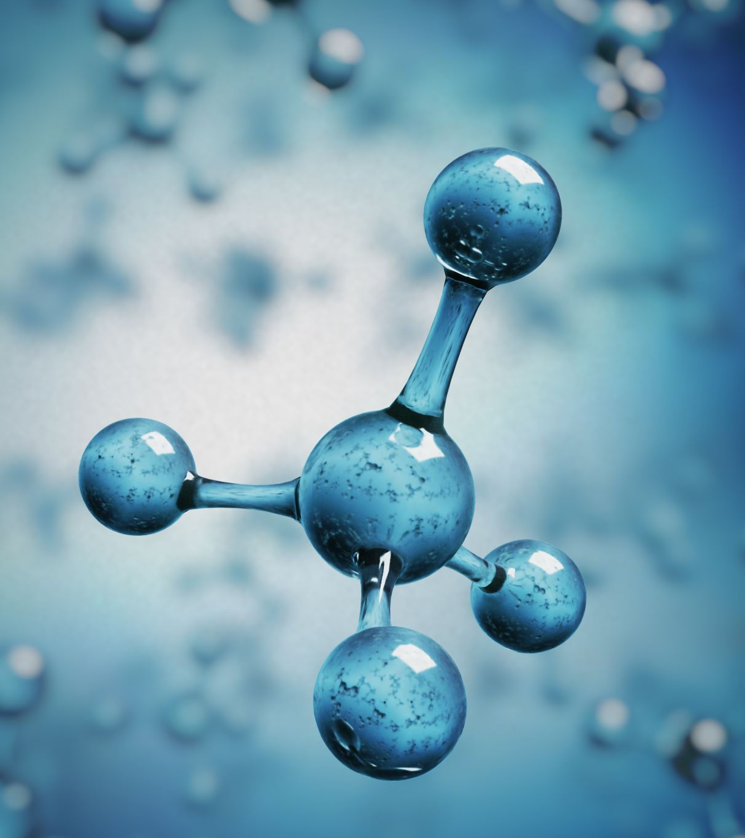
Water vapours
The main source of water vapour is burning of hydrocarbons.
This produces carbon dioxide and water.
hydrocarbon + oxygen > carbon dioxide + water vapour

Slide 6
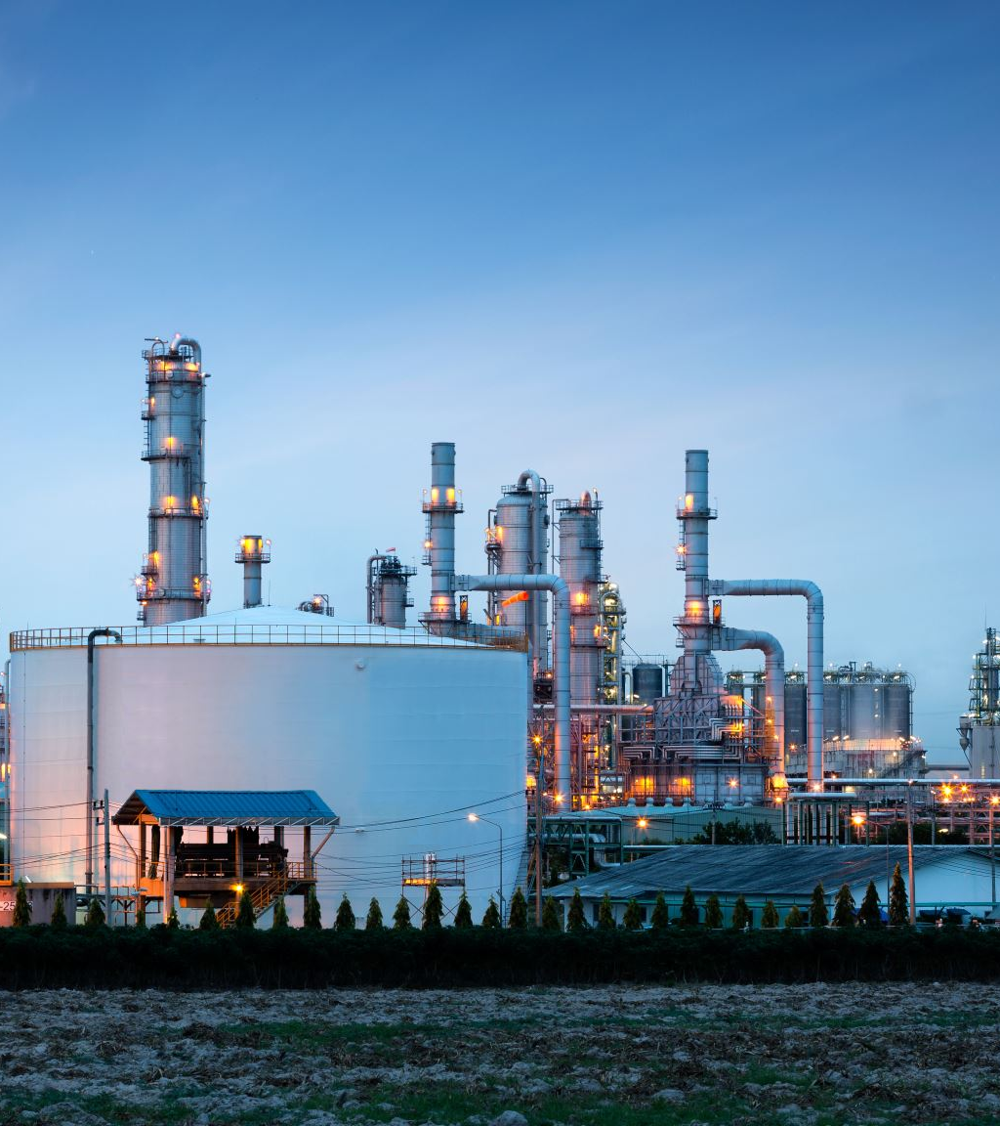
Oxides of nitrogen
Combustion of fossil fuels like
Coal
Oil
Gasoline
etc

Slide 7

methane
It is emitted in large quantities during anaerobic decomposition of organic matter in soil Water and sediments.
Incomplete combustion also produces methane and other hydrocarbons

Slide 8

Mechanism of green house effects
The incoming solar energy from the sun is redirected back towards space by the atmosphere and clouds and then some of the solar energy gets absorbed by the atmosphere and clouds. And the remaining energy gets absorbed by the Earth's surface making it warm.

Slide 9

Advantages of greenhouse effect
Extend growing seasons with greenhouse plants.
A garden greenhouse offers better pest prevention.
A garden greenhouse that is portable and customizable.
The benefit of greenhouse additional growing options.
Weather protection for greenhouse plants.

Slide 10
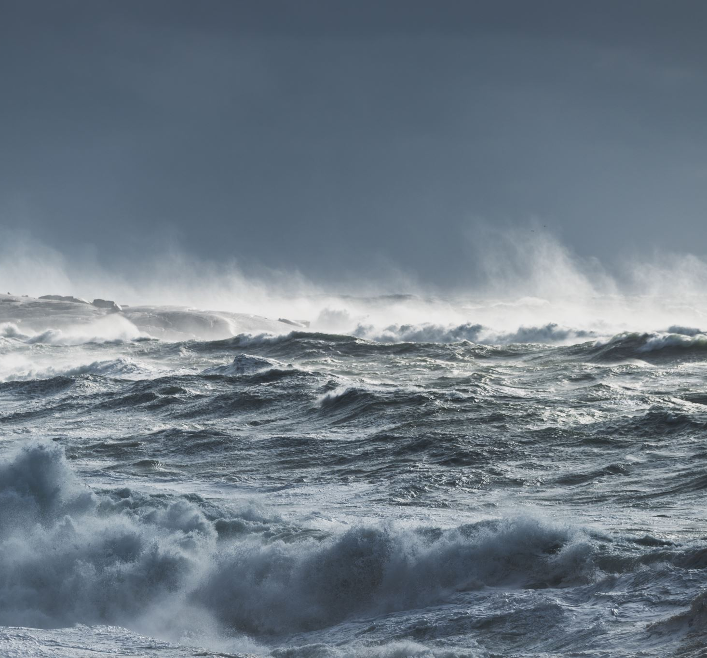
Effects of global warming
Rise in sea level.
More severe storms.
Increased drought.
A warming, rising ocean.
Loss of species.

Slide 11

Ways to reduce global warming
Minimize use f automobiles
Grow more plants
Avoid burning wood ,dried leaves,etc.
Avoid smoking
Teach people about global warming.

Slide 12

PPT by NK and syed irfan

