Slide 1
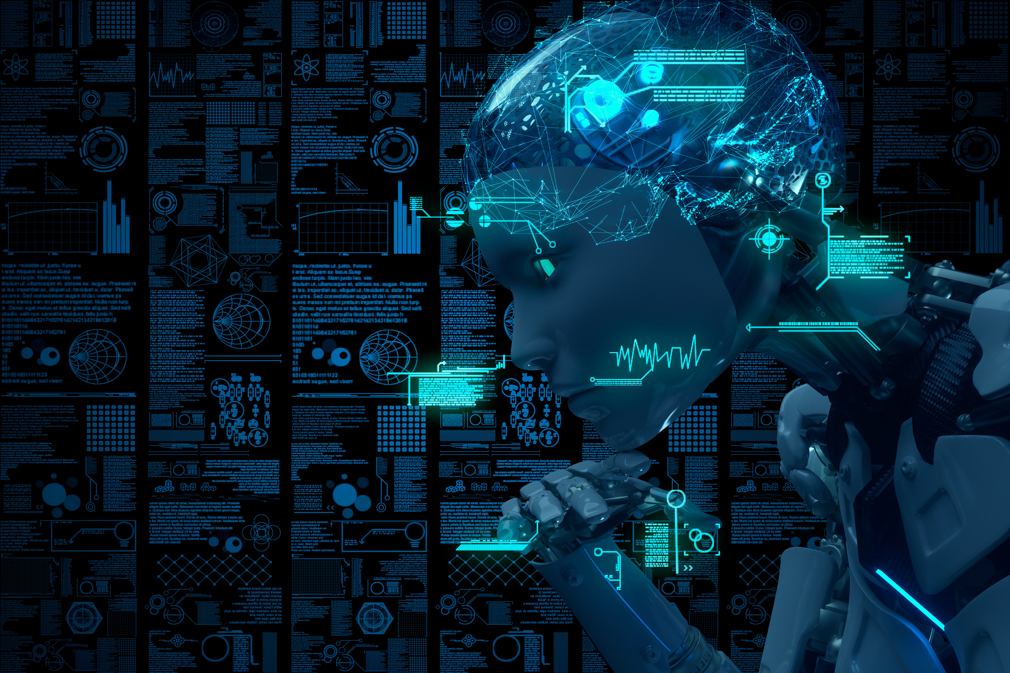
Empowering Classrooms with Artificial Intelligence
Exploring the Horizon of AI-enabled Education
Presented by: Niteesh Krishna M
Tashwin B

Slide 2

Definition of AI in education
  Personalized Learning: Tailors educational content to individual needs.
  Automated Administrative Tasks: Handles routine tasks like grading, freeing up educators' time.
  Interactive Learning Environments: Creates engaging learning experiences with virtual labs and smart content.
  Assistance and Tutoring: Offers personalized tutoring outside classroom hours.
  Global Learning Environment: Connects classrooms across the world for a multicultural learning experience.
  Predictive Analytics: Analyzes trends in student performance for timely interventions.

Slide 3


Maths
  Blended Learning Environment: Combination of traditional teaching and AI-based tools.
  Continuous Assessment: Real-time monitoring and assessments to track student’s performance.
  Collaborative Learning: Encouraging collaborative learning through AI-powered platforms.
  Lifelong Learning: Promoting self-paced and continuous learning.

Slide 4











SCIENCE
  VIRTUAL LABS: CONDUCT EXPERIMENTS IN A SAFE, CONTROLLED, VIRTUAL ENVIRONMENT.
  AI-based SIMULATIONS: VISUAL AND INTERACTIVE UNDERSTANDING OF COMPLEX SCIENTIFIC CONCEPTS.
  REAL-WORLD APPLICATIONS: AI CAN DEMONSTRATE REAL-WORLD APPLICATIONS OF SCIENTIFIC PRINCIPLES.
  AUTOMATED DATA ANALYSIS: STREAMLINE DATA COLLECTION AND ANALYSIS FOR SCIENTIFIC EXPERIMENTS.

Slide 5











Language
  Automated Language Translation: Instant translation aids in learning new languages.
  Pronunciation and Grammar Checking: Real-time feedback on pronunciation and grammar

Slide 6




HOW TEACHING DIFFERS IN AI-ENABLED CLASSROOMS

Slide 7

  Combines traditional and AI-based tools.
  Enhances student engagement.
  Real-time monitoring of student performance.
  Automates grading for efficiency.

Slide 8

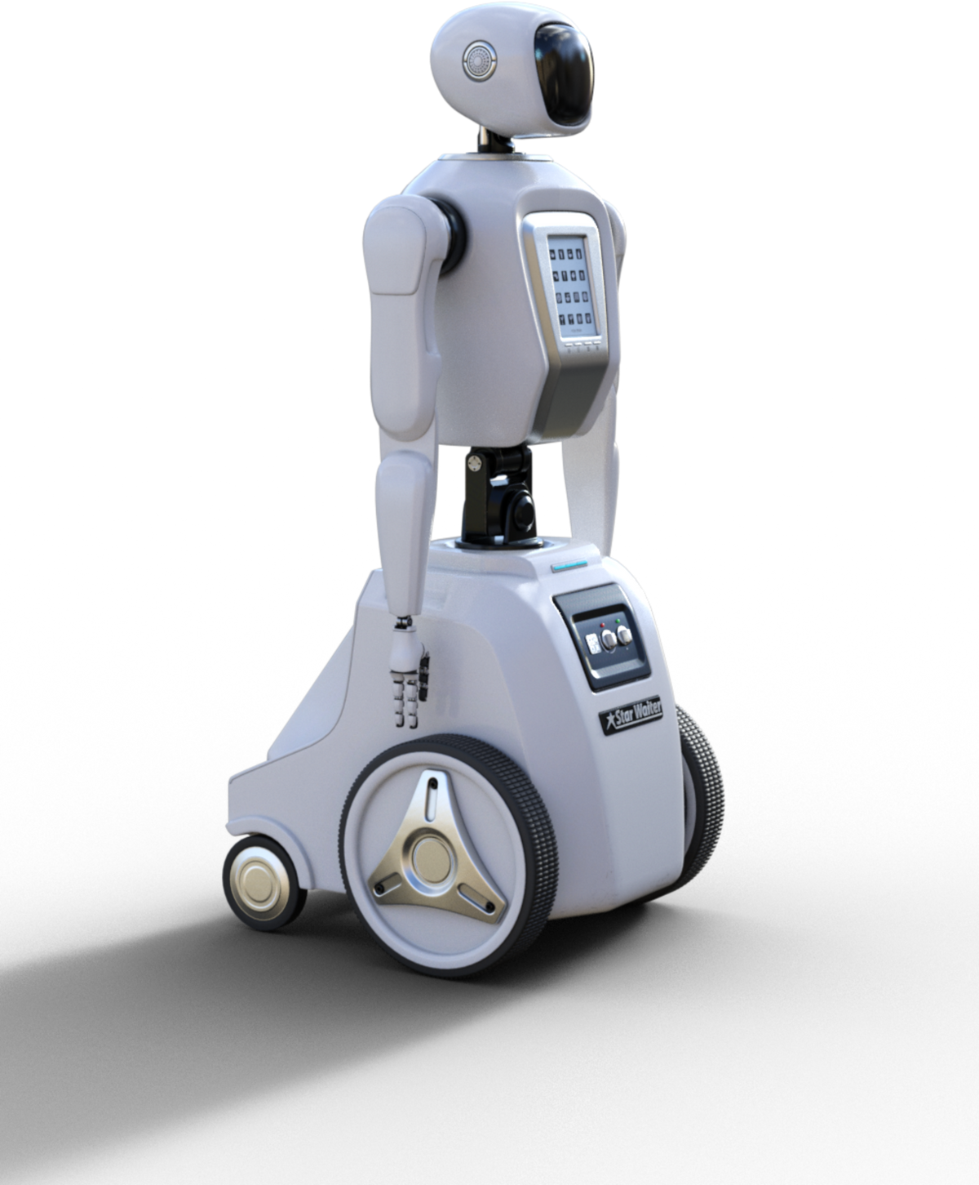



FUTURE
TECHNOLOGY
ROBOTS
REAL-WORLD EMBRACE OF AI IN EDUCATION

Slide 9
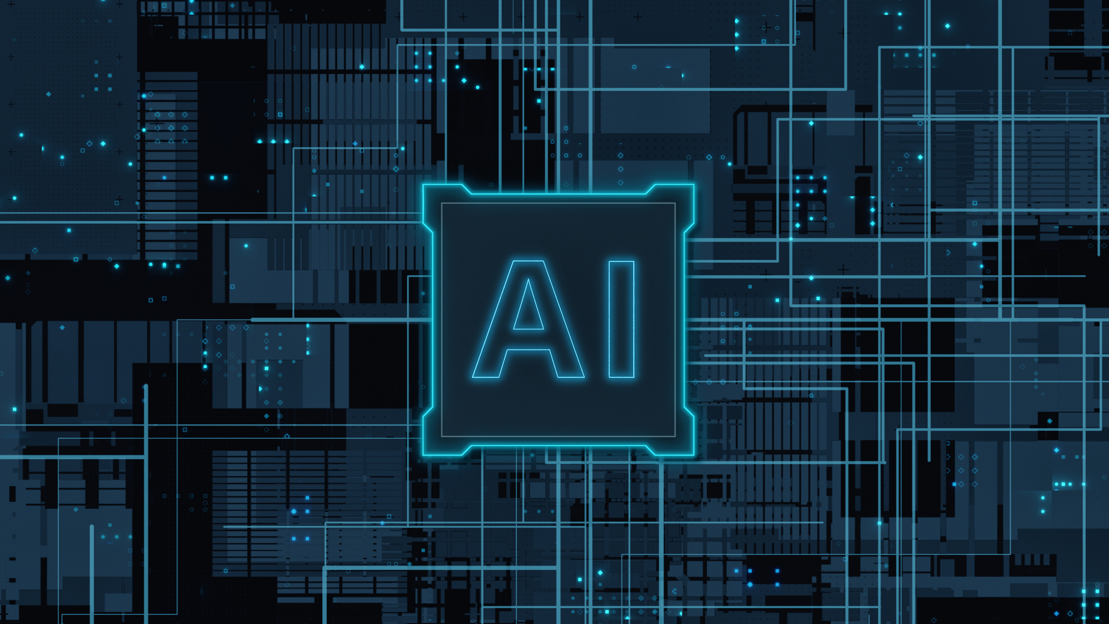
AI Applications
in Classrooms:
Adoption Across Geographies:
  Squirrel AI: An AI-driven personalized learning platform that adapts to each student's needs.
  Querium: Provides step-by-step tutoring help for complex subjects like Math and Science.
  Thinkster Math: Offers personalized math tutoring with real-time feedback.
  Countries: Places like the USA, China, and Singapore are pioneering the integration of AI in education.
  Schools: Progressive schools worldwide are adopting AI to enhance teaching and learning experiences, with notable implementations in personalized learning and administrative automation.

Slide 10


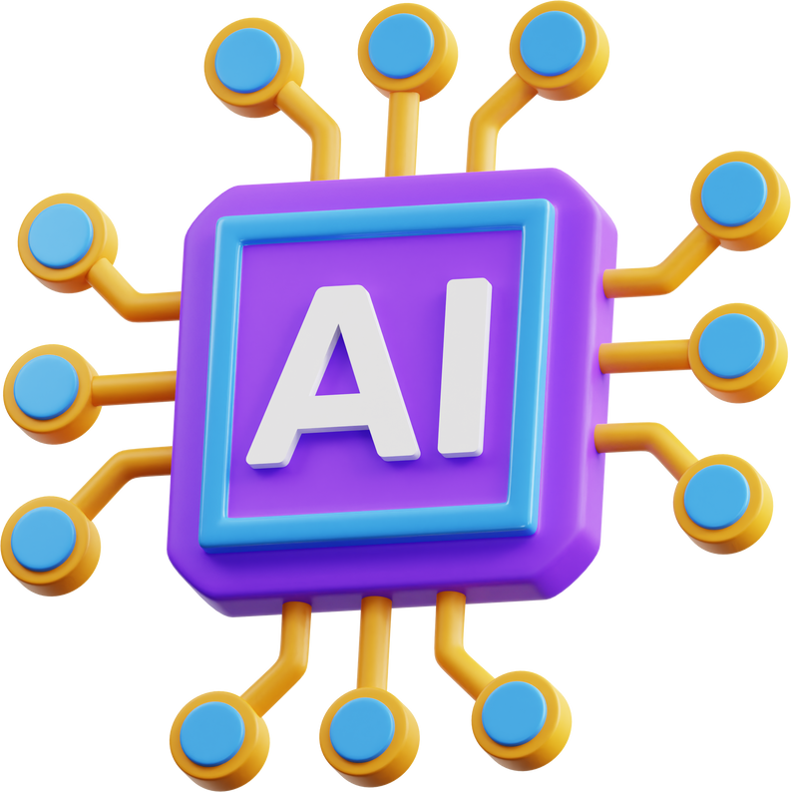

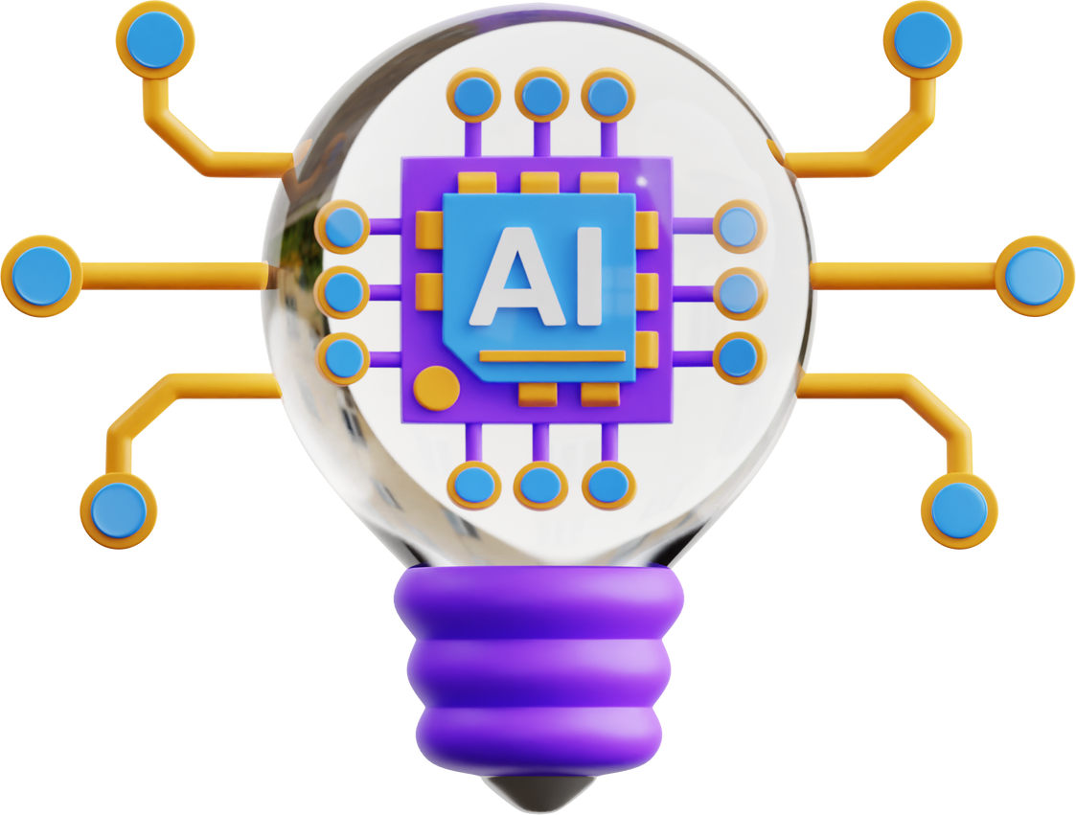
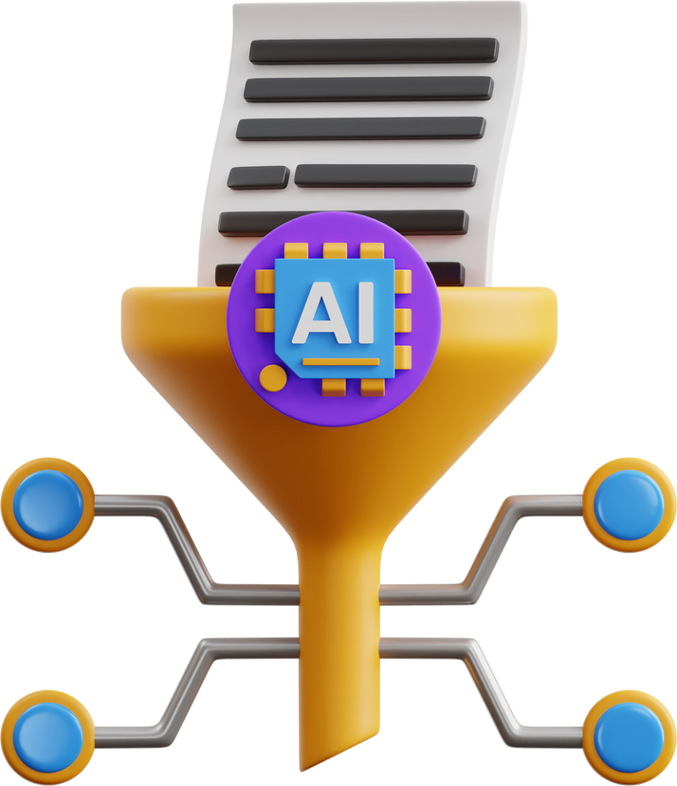
Navigating Challenges in AI-Enabled Education

Slide 11



Data
Concerns:

Slide 12



Privacy Concerns:
  Data Security: Ensuring the security and confidentiality of student and staff data in AI systems.
  Consent and Transparency: Obtaining consent and maintaining transparency about data collection and usage.
Cost
  Infrastructure Investment: Significant investment required to set up and maintain AI infrastructure.
  Cost-Benefit Analysis: Evaluating the long-term benefits against the initial and ongoing costs.

Slide 13

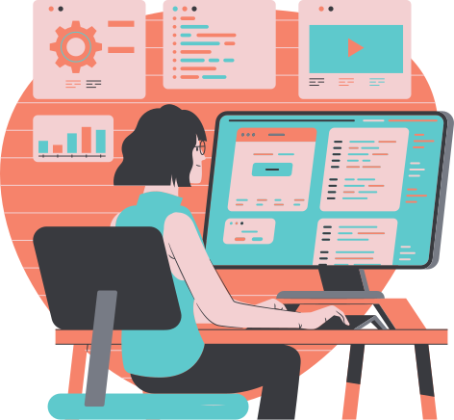
Upcoming AI Technologies in Education:
  Advanced Personalization: Further tailoring of learning experiences to individual needs and preferences.
  Voice Recognition Systems: Enhancing interaction and engagement in the classroom through voice-activated systems.
Potential Impact on Educational Equity and Accessibility:
  Bridging Educational Gaps: AI could help bridge educational gaps by providing personalized learning opportunities to students irrespective of geographical and socio-economic barriers.
  Enhanced Accessibility: AI can make education more accessible through speech recognition, language translation, and other assistive technologies for differently-abled students.

Slide 14



Summary

Slide 15
AI's integration in classrooms augments personalized learning, continuous assessment, and collaborative learning.
Despite challenges like privacy concerns and costs, the potential benefits in educational equity and accessibility are substantial.
Real-world examples like Squirrel AI and countries like the USA illustrate the growing adoption of AI in education.

Slide 16

Thank You!

