Slide 1



RESPECT SHAPES
YOUR FUTURE
PPT BY Niteesh Krishna

Slide 2
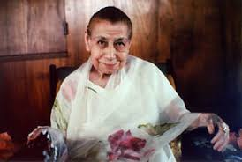
MOTHER’S QUOTE
-Khushboo
TRUE RESPECT COMES FROM A QUIET STRENGTH WITHIN, NOT FROM FEAR.
— MIRA ALFASSA

Slide 3
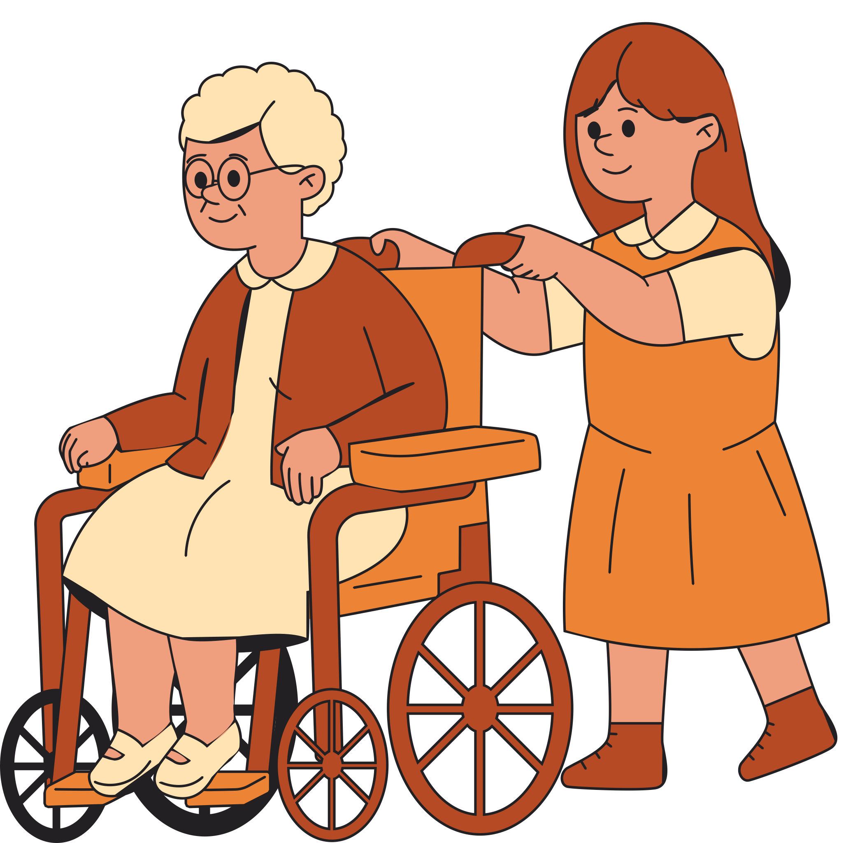
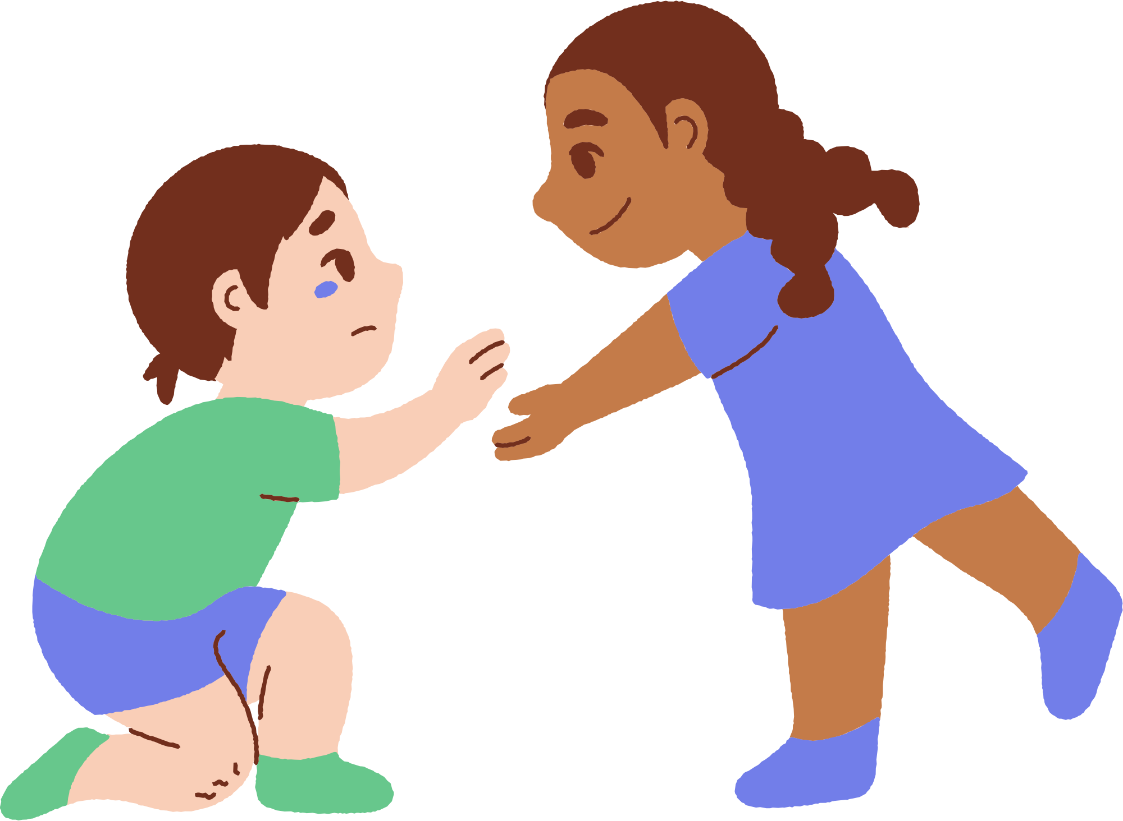
THOUGHT - Jessica
RESPECT IS NOT JUST ABOUT WHAT WE SAY
IT’S HOW WE ACT, LISTEN, AND TREAT OTHERS WITH KINDNESS.

Slide 4
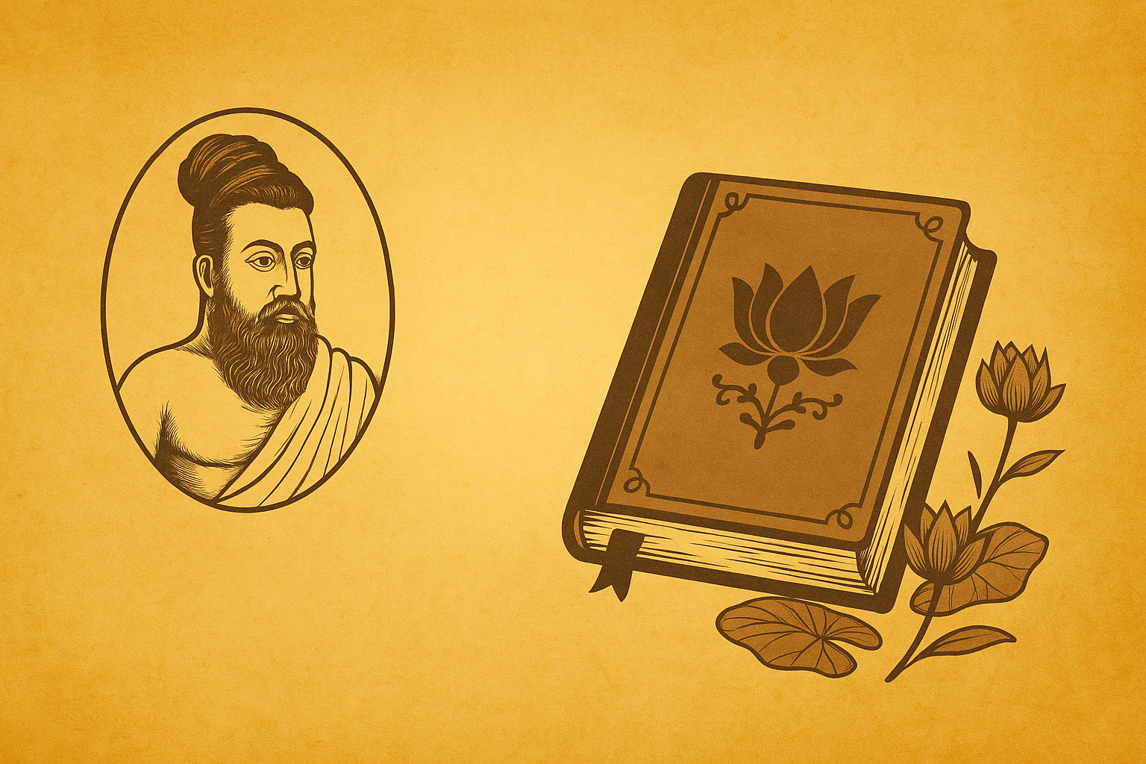
திருக்குறள்
திருக்குறள்
~Rebecca

Slide 5
அதிகாரம் 14, குறள் 131:
முப்பொருள் மூன்றின் விளக்கம் ஒருங்குச்செல் முப்பதின் மூன்றும் தரும்
Reverence to elders gives you the benefit of virtue, wealth, and pleasure; it brings the fruit of all three pursuits in life

Slide 6

BY Zishaan

Slide 7
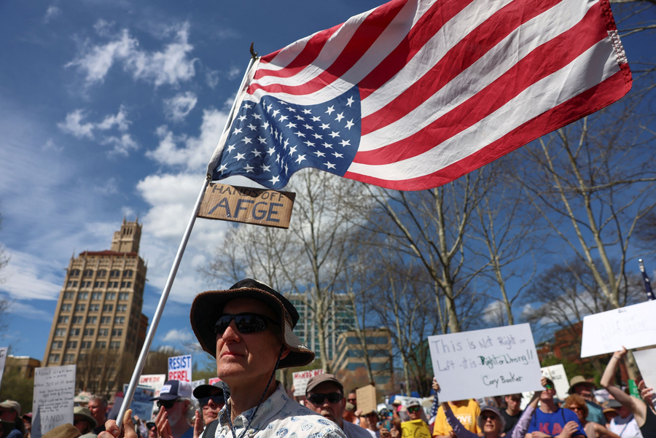

INTERNATIONAL NEWS
Massive protests erupted across the United States in response to cuts in social services, federal jobs, and immigrant and transgender rights. ​
A powerful earthquake struck near Papua New Guinea, prompting tsunami warnings and evacuation efforts. ​

Slide 8
NATIONAL NEWS
India and Sri Lanka have signed agreements to collaborate on the Trincomalee project and power grid interconnection, aiming to boost regional growth.
Modhera village in Gujarat, India’s first fully solar-powered village, has received international praise for sustainable energy usage and self-sufficiency. It has become a model for renewable energy projects across the country.

Slide 9
STATE NEWS
Prime Minister Narendra Modi inaugurated the New Pamban Bridge, India's first vertical-lift sea bridge, enhancing connectivity to Rameswaram.
Chennai Volunteers Protect Endangered Sea Turtles
For nearly four decades, dedicated volunteers in Chennai have been patrolling the city's beaches at night to safeguard the endangered olive ridley sea turtles This year alone, over 260,000 turtle eggs have been protected

Slide 10
SCIENCE AND TECHNOLOGY
NASA astronauts aboard the International Space Station
are conducting experiments to study how bacteria and fungi grow in microgravity. This helps scientists prepare for
long-term space missions like Mars travel.
India has introduced its first AI language chip called “Vaakya”, designed to process Indian languages for speech-to-text and translation tools.

Slide 11

SPORTS NEWS
IN THE 23RD MATCH OF IPL , GUJARAT TITANS DEFEATED RAJASTHAN ROYALS BY 58 RUNS.

Slide 12
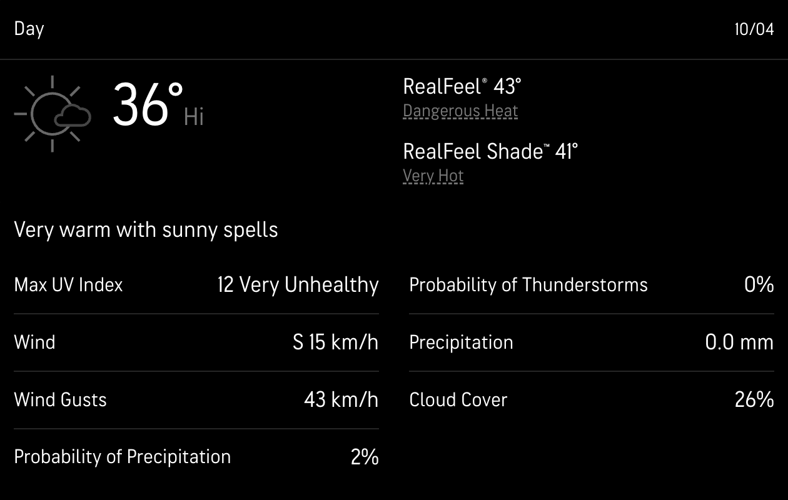
WEATHER

Slide 13



Slide 14


Archita & Harshita

Slide 15
RULES
NO CHORUS ANSWERS
PLEASE RAISE YOUR HAND
AND RESPECT ALL THE RULES
We will be asking a series of questions and will call out those names starting with the letters in the word R E S P E C T to answer the questions.

Slide 16
SCENARIO 1: R
AISHA IS WORKING ON A GROUP PROJECT WITH THREE OTHER CLASSMATES. ONE CLASSMATE, RAHUL, IS CONSTANTLY CHECKING HIS PHONE AND OCCASIONALLY INTERRUPTING AISHA WHEN SHE'S SHARING HER IDEAS. HOWEVER, RAHUL ALWAYS SAYS "EXCUSE ME" BEFORE INTERRUPTING.
QUESTION: IS RAHUL'S BEHAVIOR RESPECTFUL OR DISRESPECTFUL?

Slide 17
Answer:
DISRESPECTFUL

Slide 18
SCENARIO 2: E
RANI’S FAMILY HAS A TRADITION OF SPEAKING ONLY IN THEIR NATIVE LANGUAGE AT HOME. WHEN RANI BRINGS HER FRIEND, WHO DOESN'T UNDERSTAND THE LANGUAGE, OVER FOR DINNER, RANI AND HER FAMILY CONTINUE THEIR CONVERSATION IN THEIR NATIVE LANGUAGE.
QUESTION: IS RANI’S FAMILY'S BEHAVIOR RESPECTFUL OR DISRESPECTFUL TOWARDS RANI’S FRIEND?

Slide 19
Answer:
DISRESPECTFUL

Slide 20
SCENARIO 3: S
DURING A SCHOOL DEBATE, ROHAN STRONGLY DISAGREES WITH HIS OPPONENT'S POINT. HE ROLLS HIS EYES AND SIGHS AUDIBLY WHILE HIS OPPONENT IS SPEAKING.
QUESTION: IS ROHAN'S BEHAVIOR RESPECTFUL OR DISRESPECTFUL?

Slide 21
Answer:
DISRESPECTFUL

Slide 22
SCENARIO 4: P
DURING LUNCH BREAK, SATYA ACCIDENTALLY BUMPS INTO RANI, MAKING HER DROP HER WATER BOTTLE. INSTEAD OF WALKING AWAY, SATYA IMMEDIATELY PICKS IT UP AND SAYS, “I’M SO SORRY, RANI. ARE YOU OKAY?” RANI SMILES AND SAYS IT’S ALRIGHT.
QUESTION: WAS THIS RESPECTFUL OR DISRESPECTFUL?

Slide 23
Answer:
RESPECTFUL

Slide 24
SCENERIO 5:E
WHILE WALKING TO THE BUS STOP, A STUDENT SEES AN ELDERLY LADY STRUGGLING TO CARRY HER BAGS. THE STUDENT POLITELY OFFERS TO CARRY ONE OF THE BAGS AND HELPS HER CROSS THE ROAD SAFELY. THE LADY THANKS THEM WITH A BIG SMILE
QUESTION: WAS THIS RESPECTFUL OR DISRESPECTFUL?

Slide 25
Answer:
RESPECTFUL

Slide 26
SCENERIO 6: C
A GROUP OF STUDENTS ARE WORKING IN THE SCHOOL LIBRARY. ONE STUDENT, ARYA, NOTICES HER FRIEND ARYAN TALKING LOUDLY TO HIS FRIEND. THE LIBRARIAN HAS ALREADY REMINDED EVERYONE TO STAY QUIET. ARYA WALKS OVER AND QUIETLY SAYS, “HEY, ARYAN, LET’S KEEP IT DOWN. OTHERS ARE TRYING TO STUDY.” ARYAN NODS, APOLOGIZES, AND LOWERS HIS VOICE.
QUESTION: WAS THIS RESPECTFUL OR DISRESPECTFUL?

Slide 27
Answer:
RESPECTFUL

Slide 28
SCENERIO 7: T
DURING CLASS, THE TEACHER ASKS A STUDENT NAMED RHEA TO READ HER ESSAY ALOUD. RHEA IS NERVOUS AND STUMBLES OVER A FEW WORDS. A FEW CLASSMATES AT THE BACK START WHISPERING AND LAUGHING AT HER. SHE HEARS THEM, GETS EMBARRASSED, AND STOPS READING.
QUESTION: WAS THIS RESPECTFUL OR DISRESPECTFUL?

Slide 29
Answer:
DISRESPECTFUL

Slide 30
THANK FOR
LISTENING
We hope that our assembly was entertaining

